Slide 1
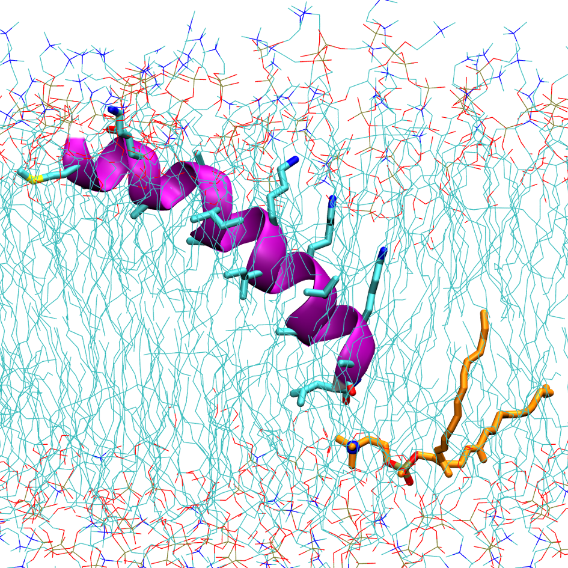
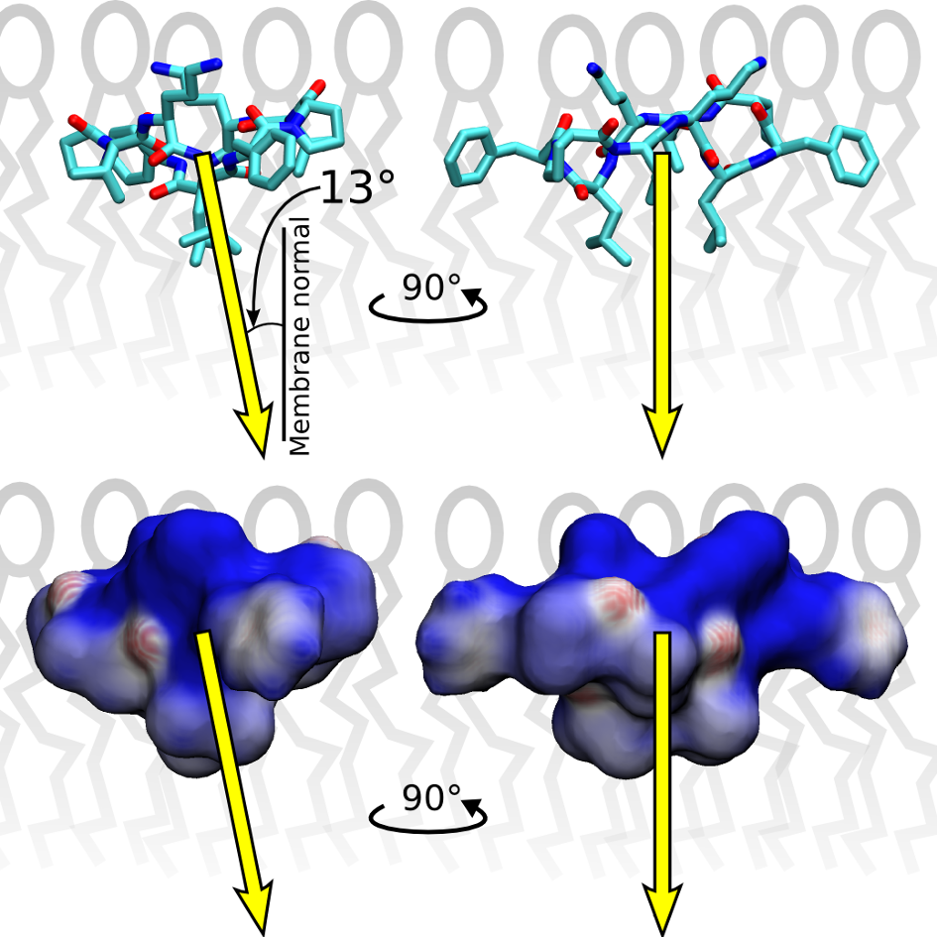
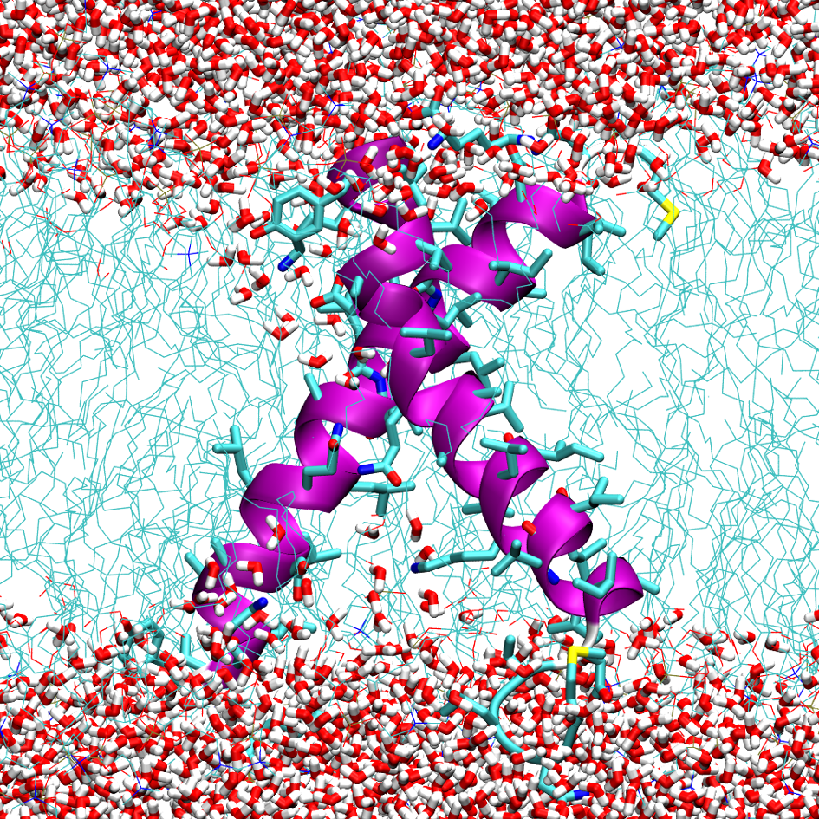
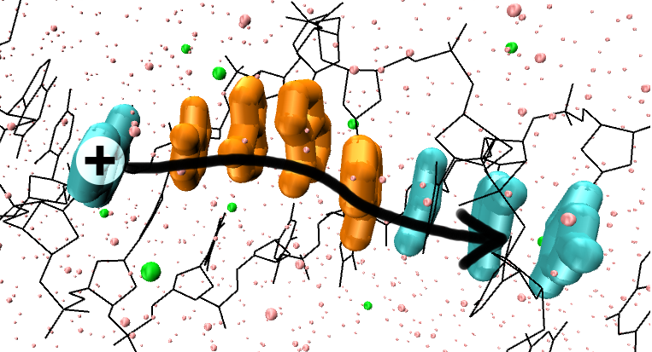
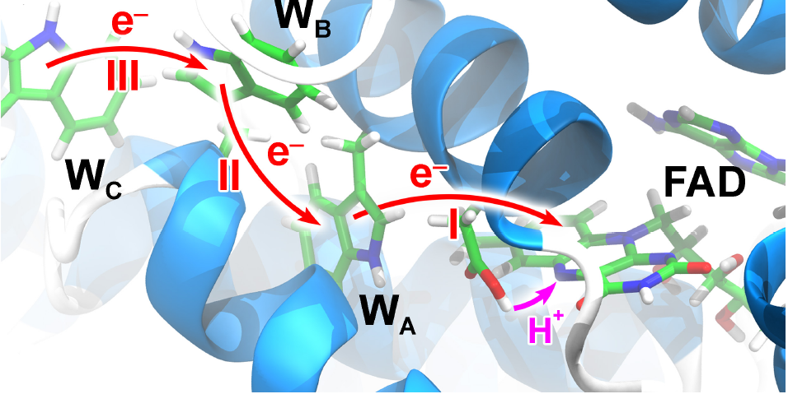
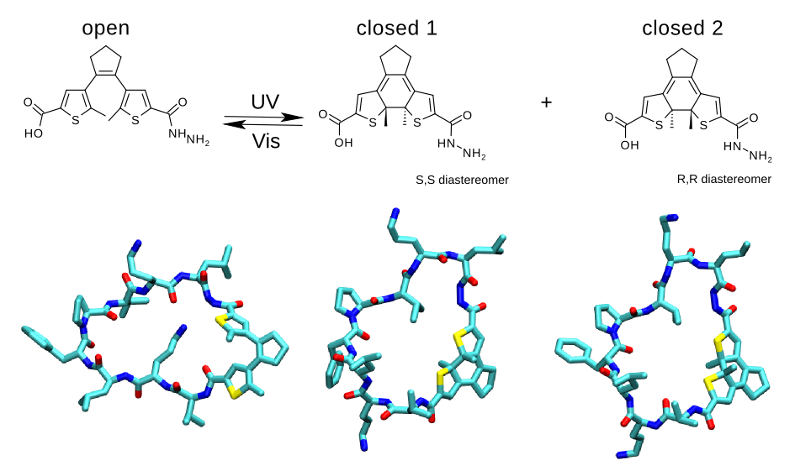
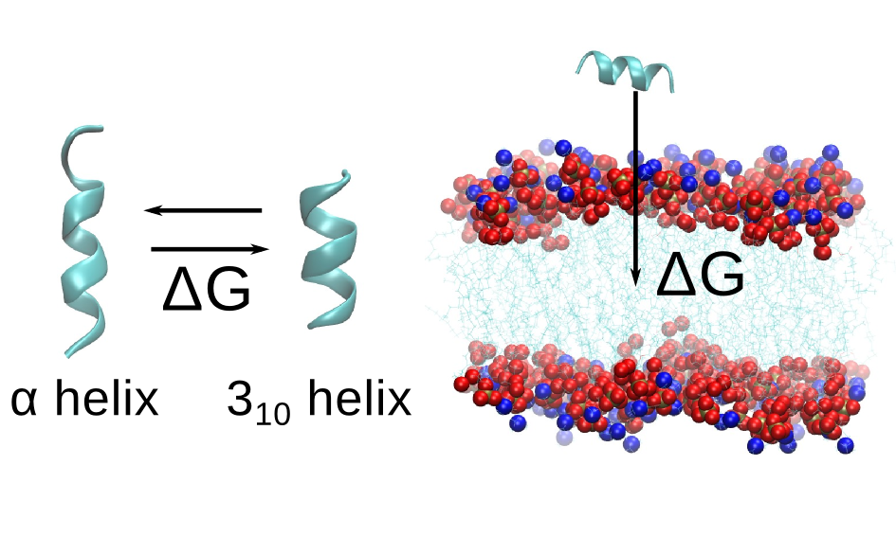
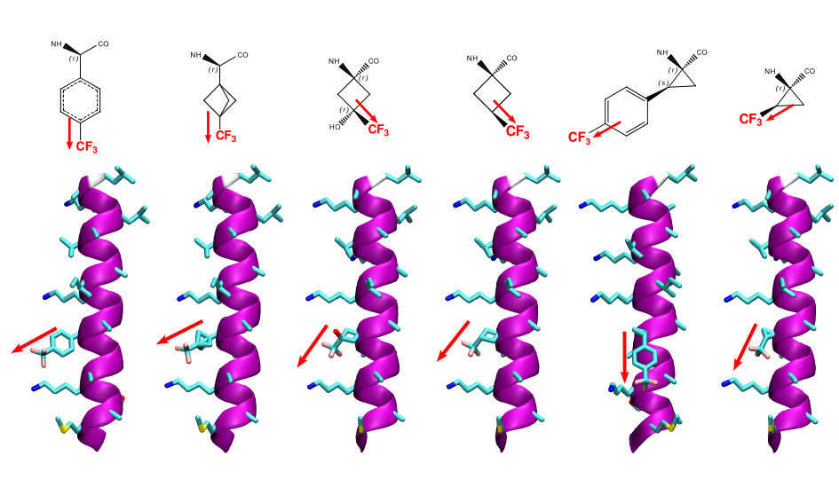
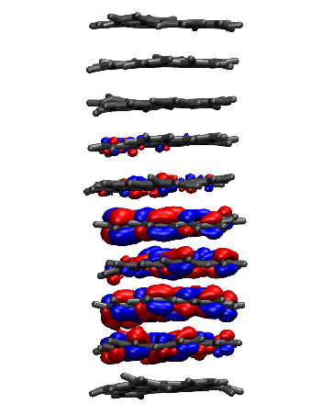
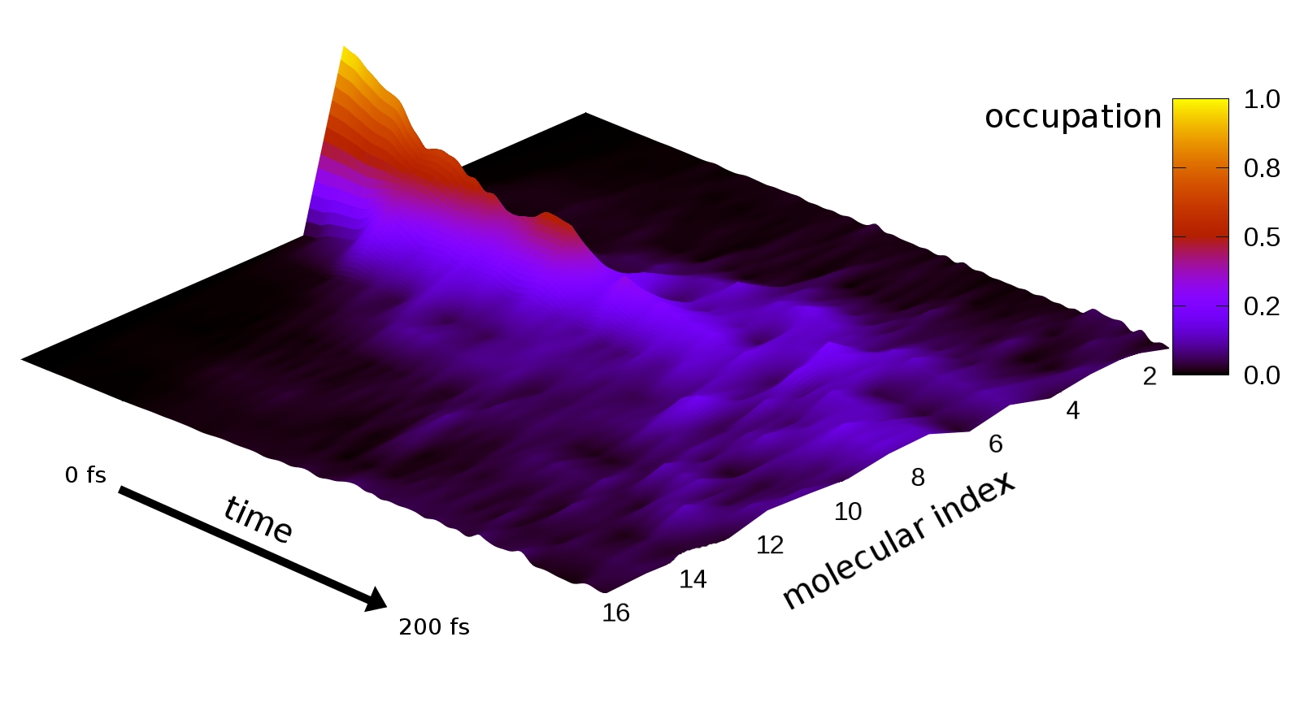
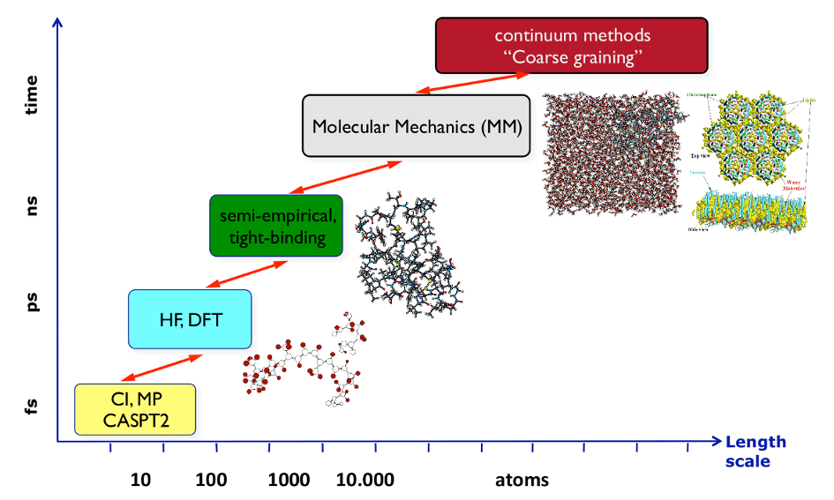
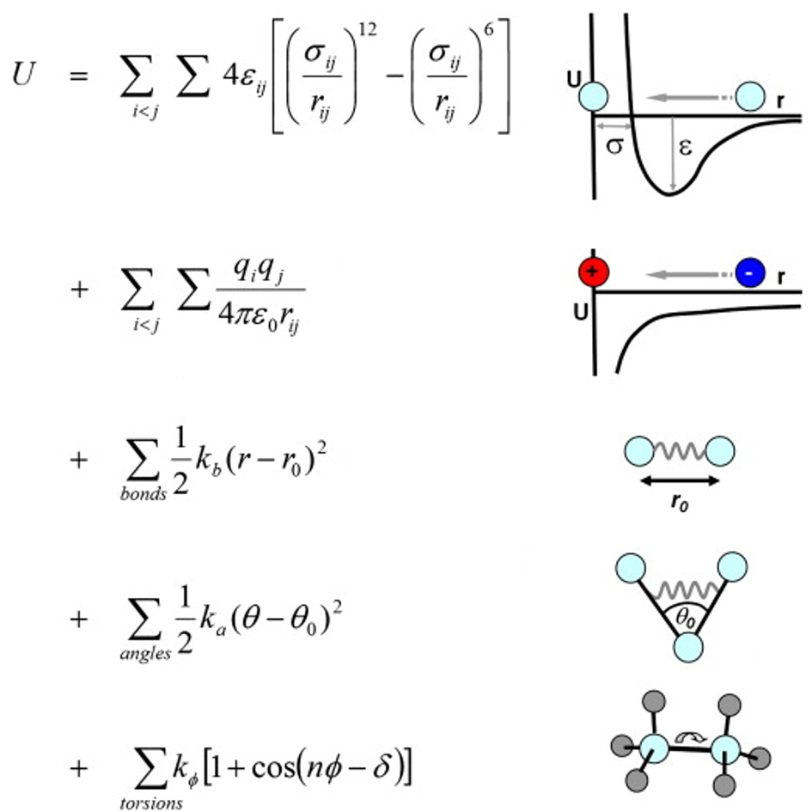
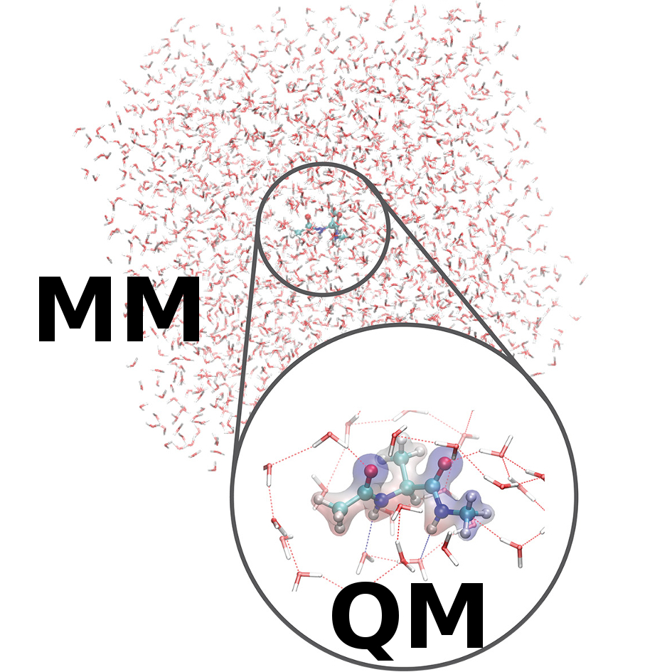
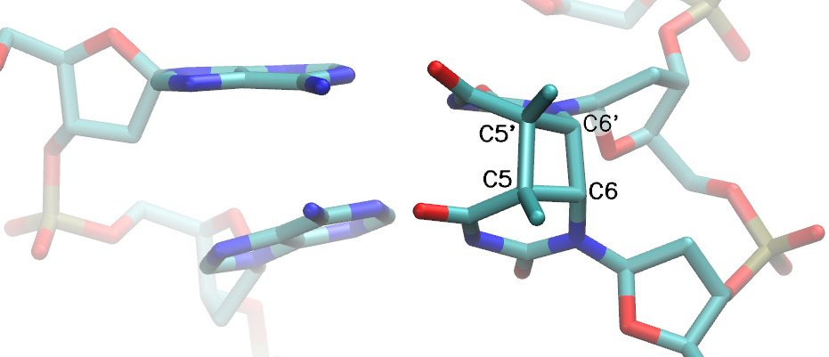
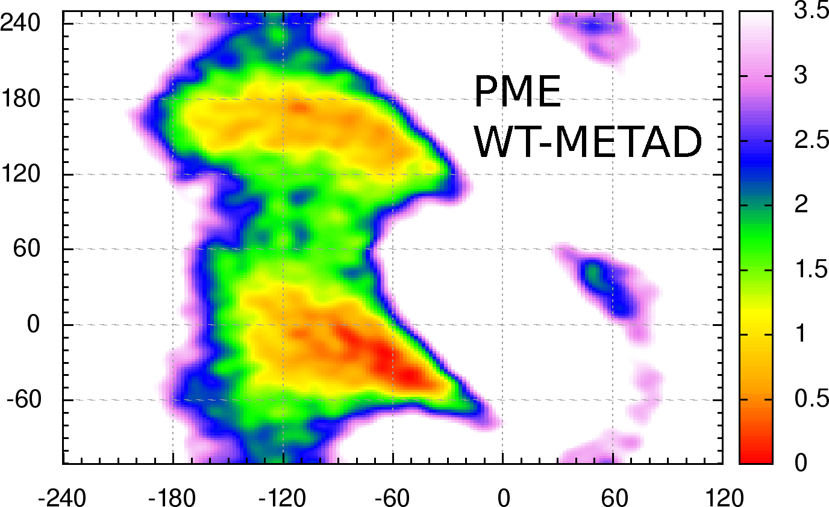
Theoretical Chemical Biology
Keywords
Molecular Modeling and Theoretical Chemistry
Molecular Biophysics
Organic Electronics
Multi-scale simulations
DFT and big data
M. Elstner, S. Reißer
Institut für Physikalische Chemie
*Ansprechpartner (m.elstner@kit.edu)
Membrane-active peptides
- close collaboration NMR experimentalists from
AK Ulrich
- space- and time-resolved insight into processes which are experimentally not accessible
- classical molecular dynamics and free energy methods
Electron transfer
- crucial properties of electrons – delocalization and mobility
- non-adiabatic multi-scale QM/MM simulation
ET in biophysics
ET in materials for organic electronics
Step of quantum-chemical propagation
– dynamics of the excess electron or hole
– time-dependent Schrödinger equation
– Hamiltonian involves the effect of structural dynamics
Step of classical propagation
– dynamics of the entire complex molecular system
– classical molecular mechanics + Newton's eqns
– the excess charge mapped onto the classical atoms
All-atom molecular dynamics simulations of membrane-active peptides
Prediction of membrane-inserted orientation via hydrophobic moment vector
The host defense peptide TisB, which decreases the proton gradient across the bacterial membrane
Hole transfer between DNA bases
– complex system – strongly polarizable
environment drives the transfer
– large spatial as well as temporal scales
– nanometers and nanoseconds
Hole transfer in a protein
– DNA photolyase family
– polarizable solvent creates a down-hill
path for electron transfer
– sequential transfer – overlap of times scales
– coupled multi-scale scheme necessary
Structure-function relation of peptidomimetics with integrated photoswitch, with antimicrobial activity that can be switched on/off by light
Determination of secondary structure of the peptaibol HK VI, free energy calculations
Parametrization of novel amino acids for 19F NMR, calculation of structural parameters
Charge transport regime in between localized hopping and delocalized band transport.
Scattering on phonons leads to
diffusive motion of the charge carrier.
Methodology in Theoretical Chemical Biology
Quantum Chemistry and Molecular Mechanics
Classical Mechanics: Force-Fields
Quantum Mechanics:
Density Functional
Tight Binding (DFTB)
Molecular Mechanics
No explicit electrons Atoms are point particles with masses and charges
Molecules described with harmonic springs and other simple analytical potentials
→ very efficient computation at the cost of considerable approximation
Atoms are balls with masses and charges
Molecules composed of springs and empirical potentials
=> Very fast computation but loss of quantum information
Approxmation to Density Functional Theory (DFT) in order to compute
more atoms and larger timescales with quantum information.
Taylor Expansion around DFT Energy Functional
Tabulated Hamiltonian and overlap for each element pair
No integral computation at run-time
Timings: Calculating the energy of an icosahedral cluster composed
of 100 water molecules with different methods.
=> DFTB3 model is up to three orders of magnitude faster than DFT!
Quantum Chemistry:
Density Functional
Tight Binding (DFTB)
Multi-scale: QM/MM
Small region of interest – described with quantum chemistry,
the less-interesting rest
– treated with molecular mechanics
DFTB3 – implementation
in Gromacs 5 package
– tight integration within the program
– favorable efficiency
– full PME-based treatment
of QM/MM electrostatics
– QM/MM calculations of free energies
(Gromacs internal and Plumed plugin)
– adaptive QM/MM – for H2O moving between QM / MM regions – discontinuities avoided
– efficient parallelization
Thymine dimer lesion in DNA Well-tempered metadynamics
– repair via electron uptake simulation of alanine dipeptide
simulated with QM/MM – application of advanced – umbrella sampling simulation free energy techniques
Approximation to the density functional theory (DFT) to calculate larger molecular systems and
perform longer molecular dynamics simulations while preserving quantum mechanical description
Taylor expansion of DFT energy
Tabulated Hamiltonian and overlap for each element pair
No integral computation at run-time
Timing: Calculation of energy of a cluster of 100 water molecules:
→ DFTB3 is ca. 1000× faster than DFT!
See www.dftb.org, www.dftb-plus.info
Multiscale: The QM/MM Scheme
Here could be more text about the timescale picture and general QM/MM.
Want to learn more? Visit
http://www.dftb.org/
http://www.dftb-plus.info/
http://www.gromacs.org/
Using quantum mechanics (QM) for a small but important part of the system while the rest is modeled by molecular mechanics (MM).
Adressierte gesellschaftliche Bedarfsfelder
Information
Energie
Gesundheit
Ausrichtung der Forschung
primär Grundlagen
primär Anwendung
beides gleichwertig
Schnittstellen zu anderen Bereichen (optional)
Bereich A (optional Institut / Thema)
Bereich B
Bereich C
x

